Slide 1
AWS Essentials
IAM and Cloud Compute
SoftUni Team
Technical Trainers
Software University
https://softuni.org

Slide 2
Table of Contents
1. Overview of IAM
2. IAM Groups, Users, Roles and Policies
3. IAM Hands-On
4. Compute 101
5. EC2 Overview
6. EC2 Hands-On
2
Notes:
2

Slide 3
Have a Question?
sli.do
# AWS-essentials
Notes:
3

Slide 4

Overview of IAM

Slide 5


What is IAM ?
IAM (Identity Access Management) is the service where AWS user accounts and their acess to various AWS services is managed.
The common use of IAM is to manage:
Users
Groups
Roles and Access Policies
User credentials
Multi Factor Authentication
Api Keys for programmatic (CLI) access

Slide 6

IAM Best Practices
AWS Best Practices : Guidelines that recommend settings, configurations, and architecture for maintaining a high level of security, accessibility and efficiency.
When a new AWS root account is created, it is best practice to complete the following tasks :
Delete your root access keys
Activate MFA on your root account
Create Individual IAM users
Use groups to assing permissions
Apply IAM password policy

Slide 7

What is MFA ?
It is additional layer of security on your root account, that is provided by a third party.
How do you get an MFA code ?
Virtual MFA Device - Google Authenticator
Hardware key fob – ordered from AWS directly – small physical device
API keys for programmatic access

Slide 8


MFA Diagram
MFA 123 - 456
Username and password
MFA Code
Access Granted

Slide 9
Best Practices for IAM
For Users:
Never use your root user
If you want full access, create new user and attach AdministratorAccess policy to it
For Groups:
Groups are more efficient way to manage account permissions
Groups allow you to manage permissions for multiple users at the same time

Slide 10
IAM Users
IAM Users are individuals granted access to AWS account.
Each IAM User has three main components:
Username
Password
Permissions
Without permissions being explicitly granted to an AWS User, that user will not be able to access any AWS service

Slide 11

Elastic Compute Cloud

Slide 12


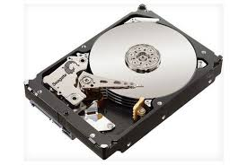
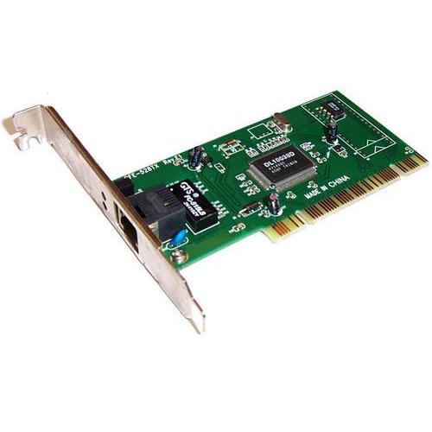

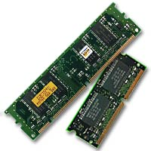
Compute 101
Operating System
CPU
Hard Drive
Network Card
Firewall
RAM

Slide 13
What is EC2 ?
AWS Definition:
Amazon EC2 provides scalable computing capacity. Using Amazon EC2 eliminates your need to invest in hardware upfront, so you can develop and deploy applications faster.
You can use Amazon EC2 to launch as many or as few virtual servers as you need.

Slide 14
ЕC2 101
AMI
Instance Type
EBS
IP Address
Security Groups
RAM

Slide 15
EC2 Instance Purchasing Options
On Demand
This option allows you to choose any instance type you like and provision/terminate it at any time .
This is the most expensive and the most flexible option
You are only charged when the instance is running.
Reserved
Allows you to purchase an instance for a set period of 1 or 3 years.
Significant price discount compared to on demand.
You own it for the reserved period, and you're responsible for the full price, regardless how often you use it.

Slide 16
EC2 Instance Purchasing Options
Spot
Amazon EC2 Spot Instances let you take advantage of unused EC2 capacity in the AWS cloud. Spot Instances are available at up to a 90% discount compared to On-Demand prices. You can use Spot Instances for various stateless, fault-tolerant, or flexible applications.

Slide 17
EC2 Instance Types
General Purpose
Compute Optimized
Memory Optimized
Accelerated Computing
Storage Optimized
https://aws.amazon.com/ec2/instance-types/

Slide 18
AMI Options
Community AMIs
Free to use
AWS Marketplace AMIs
Pay to use
Usually comes pre-configured and with added software
My AMIs
AMIs you create yourself

Slide 19
Security Groups
Virtual Firewall that controls traffic for one or more instances.
When you launch an instance, you associate one or more security groups with the instance. You add rules to the security group that allow traffic to or from the associated instance.

Slide 20

ЕC2 Workshop

Slide 21
Workshop
Userdata script :
#!/bin/bash
sudo yum update -y
sudo yum install -y httpd24 php56 php56-mysqlnd
sudo service httpd start

Slide 22
Questions?
Notes:
22

Slide 23












SoftUni Diamond Partners
Notes:
23

Slide 24




SoftUni Organizational Partners
Notes:
24

Slide 25

License
This course (slides, examples, demos, exercises, homework, documents, videos and other assets) is copyrighted content
Unauthorized copy, reproduction or use is illegal
© SoftUni – https://softuni.org
© Software University – https://softuni.bg
Notes:
25

Slide 26
Лиценз
Този курс (презентации, примери, демонстрационен код, упражнения, домашни, видео и други активи) представлява защитено авторско съдържание
Нерегламентирано копиране, разпространение или използване е незаконно
© СофтУни – https://softuni.org
© Софтуерен университет – https://softuni.bg
Notes:
26

Slide 27
Обучения в Софтуерен университет (СофтУни)
Софтуерен университет – качествено образование, професия и работа за софтуерни инженери
softuni.bg
Фондация "Софтуерен университет"
softuni.foundation
Софтуерен университет @ Facebook
facebook.com/SoftwareUniversity
Дискусионни форуми на СофтУни
forum.softuni.bg
Notes:
27

